Slide 1
Biological Modeling of Neural Networks
Week 2 – part 1: Biophysics of neurons
2.1 Biophysics of neurons
- Overview
2.2 Reversal potential
- Nernst equation
2.3 Hodgin-Huxley Model
2.4 Threshold in the
Hodgkin-Huxley Model
- where is the firing threshold?
2.5. Detailed biophysical models
- the zoo of ion channels
Week 2 – Biophysical modeling:
The Hodgkin-Huxley model
Wulfram Gerstner
EPFL, Lausanne, Switzerland

Slide 2
Week 2 – part 1: Biophysics of neurons
2.1 Biophysics of neurons
- Overview
2.2 Reversal potential
- Nernst equation
2.3 Hodgin-Huxley Model
2.4 Threshold in the
Hodgkin-Huxley Model
- where is the firing threshold?
2.5. Detailed biophysical models
- the zoo of ion channels

Slide 3
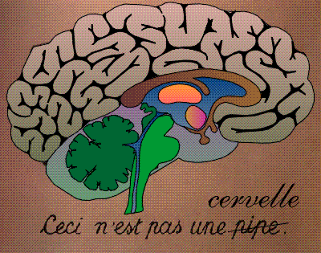
Neuronal Dynamics – 2.1. Introduction
motor
cortex
frontal
cortex
visual
cortex
to motor
output

Slide 4
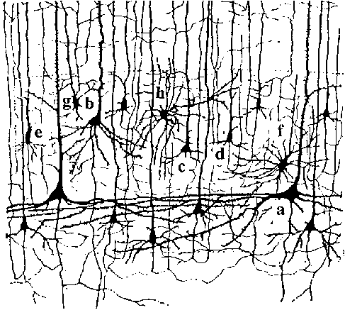
Neuronal Dynamics – 2.1. Introduction
motor
cortex
10 000 neurons
3 km wires
1mm
frontal
cortex
to motor
output

Slide 5
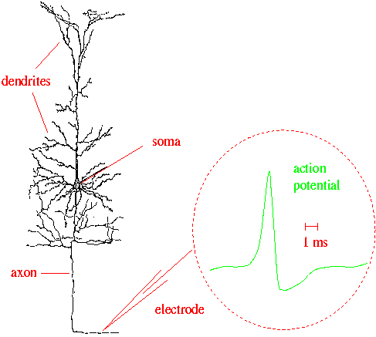
Neuronal Dynamics – 2.1 Introduction
Signal:
action potential (spike)
10 000 neurons
3 km wires
1mm
action
potential
How is a spike generated?
Ramon y Cajal

Slide 6
Review of week 1: Integrate-and-Fire models
Spike emission
synapse
t
Postsynaptic
potential
-spikes are events
-triggered at threshold
-spike/reset/refractoriness

Slide 7
Neuronal Dynamics – week 2: Biophysics of neurons
Cell surrounded by membrane
Membrane contains
- ion channels
- ion pumps
Signal:
action potential (spike)
-70mV
Na⁺
action
potential
K⁺
Ca²⁺
Ions/proteins

Slide 8
Neuronal Dynamics – week 2: Biophysics of neurons
Cell surrounded by membrane
Membrane contains
- ion channels
- ion pumps
Resting potential -70mV
→ how does it arise?
-70mV
Ions flow through channel
→ in which direction?
Na⁺
Neuron emits action potentials
→ why?
K⁺
Ca²⁺
Ions/proteins
Na⁺

Slide 9
Neuronal Dynamics – 2. 1. Biophysics of neurons
Resting potential -70mV
→ how does it arise?
Ions flow through channel
→ in which direction?
Neuron emits action potentials
→ why?
Hodgkin-Huxley model
Hodgkin&Huxley (1952)
Nobel Prize 1963
Na⁺

Slide 10
Neuronal Dynamics – 2. 1. Biophysics of neurons
Hodgkin-Huxley model
Hodgkin&Huxley (1952)
Nobel Prize 1963
Na⁺

Slide 11
Neuronal Dynamics – Quiz
In a natural situation, the electrical potential inside a neuron is
[ ] the same as outside
[ ] is different by 50-100 microvolt
[ ] is different by 50-100 millivolt
Neurons and cells
[ ] Neurons are special cells because they are surrounded by a membrane
[ ] Neurons are just like other cells surrounded by a membrane
[ ] Neurons are not cells
Ion channels are
[ ] located in the cell membrane
[ ] special proteins
[ ] can switch from open to closed
If a channel is open, ions can
[ ] flow from the surround into the cell
[ ] flow from inside the cell into the
surrounding liquid
Multiple answers possible!

Slide 12
Biological Modeling of Neural Networks
Week 2 – part 2: Reversal potential and Nernst equation
2.1 Biophysics of neurons
- Overview
2.2 Reversal potential
- Nernst equation
2.3 Hodgin-Huxley Model
2.4 Threshold in the
Hodgkin-Huxley Model
- where is the firing threshold?
2.5. Detailed biophysical models
- the zoo of ion channels
Week 2 – Biophysical modeling:
The Hodgkin-Huxley model
Wulfram Gerstner
EPFL, Lausanne, Switzerland

Slide 13
Neuronal Dynamics – 2.2. Resting potential
Cell surrounded by membrane
Membrane contains
- ion channels
- ion pumps
Resting potential -70mV
→ how does it arise?
-70mV
Ions flow through channel
→ in which direction?
Na⁺
Neuron emits action potentials
→ why?
K⁺
Ca²⁺
Ions/proteins
Na⁺

Slide 14
Neuronal Dynamics – 2. 2. Resting potential
Resting potential -70mV
→ how does it arise?
Ions flow through channel
→ in which direction?
Neuron emits action potentials
→ why?
Hodgkin-Huxley model
Hodgkin&Huxley (1952)
Nobel Prize 1963
Na⁺

Slide 15
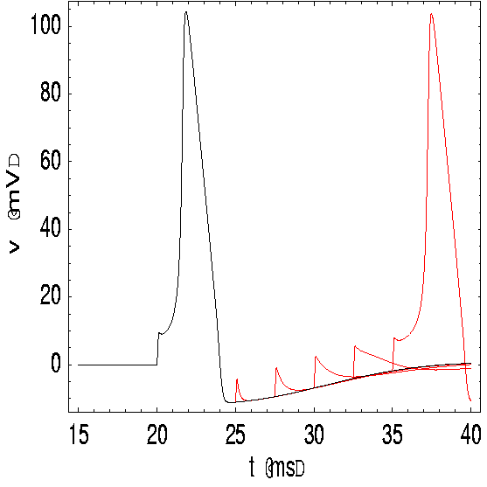
Neuronal Dynamics – 2. 2. Reversal potential
inside
100
Ka
K
density
mV
Na
outside
Ion channels
Ion pump
0
Ion pump ⬄ Concentration difference
E
Mathetical derivation
Notes:
山越高，空气越稀薄，因为海拔越高，空气分子的密度就越小。一般来说，空气分子到处运动，但因为分子有质量，所以海拔高的地方，空气分子相对比较少。高处的空气分子能量比低的要高，
同样道理，charged ion也更倾向于在低处而不是高处。这个分布符合Boltzmann distribution，我们可以通过这个分布用电压差得到分布。

Slide 16
Neuronal Dynamics – 2. 2. Nernst equation
inside
100
K
Ka
mV
Na
outside
0
Ion channels
Ion pump

Slide 17
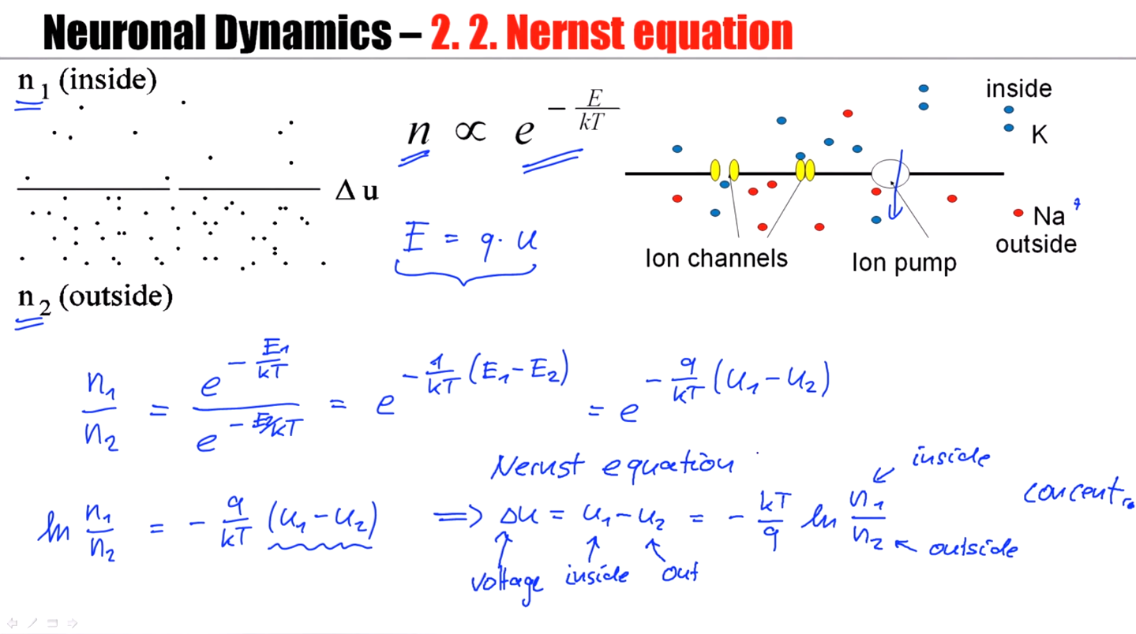

Slide 18
Neuronal Dynamics – 2. 2. Nernst equation
inside
100
Ka
K
mV
Na
outside
0
Ion channels
Ion pump
Reversal potential
Concentration difference ⬄ voltage difference
Notes:
对每一种离子的reversal potential

Slide 19
Neuronal Dynamics – 2. 2. Reversal potential
inside
Ka
K
Na
outside
Ion channels
Ion pump
Ion pump → Concentration difference
Concentration difference ⬄ voltage difference
Reversal potential
Nernst equation

Slide 20
Exercise 1.1– Reversal potential of ion channels
Calculate the reversal potential
for Sodium
Postassium
Calcium
given the concentrations
What happens if you change
the temperature T from 37
to 18.5 degree?
Reversal potential
Next Lecture 9:45

Slide 21
Neuronal Dynamics: Computational Neuroscience of Single Neurons
Week 2 – part 3 : Hodgkin-Huxley Model
2.1 Biophysics of neurons
- Overview
2.2 Reversal potential
- Nernst equation
2.3 Hodgkin-Huxley Model
2.4 Threshold in the
Hodgkin-Huxley Model
- where is the firing threshold?
2.5. Detailed biophysical models
- the zoo of ion channels
Week 2 – Biophysical modeling:
The Hodgkin-Huxley model
Wulfram Gerstner
EPFL, Lausanne, Switzerland

Slide 22
Neuronal Dynamics – 2. 3. Hodgkin-Huxley Model
giant axon
of squid
Hodgkin-Huxley model
Hodgkin&Huxley (1952)
Nobel Prize 1963
Na⁺

Slide 23
Neuronal Dynamics – 2.3. Hodgkin-Huxley Model
Hodgkin and Huxley, 1952
inside
I
Ka
C
R_{K}
R_{Na}
R_{l}
Na
outside
Ion channels
Ion pump
Mathematical
derivation

Slide 24
Neuronal Dynamics – 2.3. Hodgkin-Huxley Model
I
C
R_{K}
R_{Na}
R_{l}

Slide 25
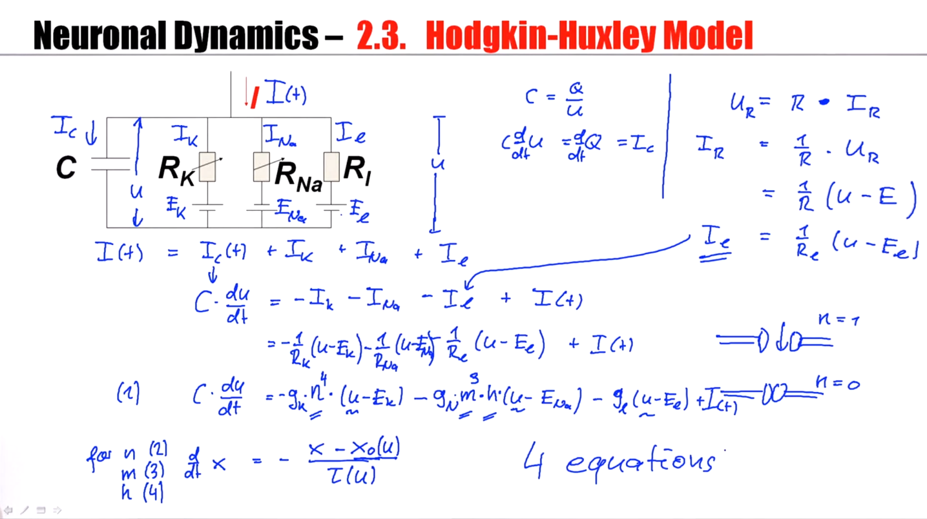

Slide 26
Neuronal Dynamics – 2.3. Hodgkin-Huxley Model
Hodgkin and Huxley, 1952
100
inside
I
Ka
C
mV
g_{K}
g_{l}
g_{Na}
Na
0
outside
Ion channels
Ion pump
stimulus
n₀(u)
u
u

Slide 27
Neuronal Dynamics – 2.3. Ion channel
r₀(u)
u
u

Slide 28
Exercise 2 and 1.2 NOW!! - Ion channel
r₀(u)
u
u
Next lecture at:
10H40

Slide 29
Biological Modeling of Neural Networks
Week 2 – part 4: Threshold in the Hodgkin-Huxley Model
2.1 Biophysics of neurons
- Overview
2.2 Reversal potential
- Nernst equation
2.3 Hodgin-Huxley Model
2.4 Threshold in the
Hodgkin-Huxley Model
- where is the firing threshold?
2.5. Detailed biophysical models
- the zoo of ion channels
Week 2 – Biophysical modeling:
The Hodgkin-Huxley model
Wulfram Gerstner
EPFL, Lausanne, Switzerland

Slide 30
Neuronal Dynamics – 2.4. Threshold in HH model
inside
Ka
Na
outside
Ion channels
Ion pump

Slide 31
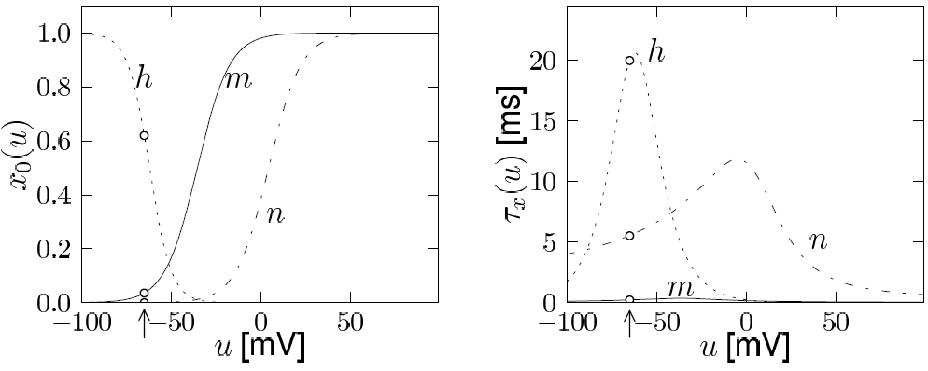
Neuronal Dynamics – 2.4. Threshold in HH model
inside
I
Ka
C
g_{K}
g_{Na}
g_{l}
Na
outside
Ion channels
Ion pump
Where is the threshold for firing?
m₀(u)
h₀(u)
u
u

Slide 32
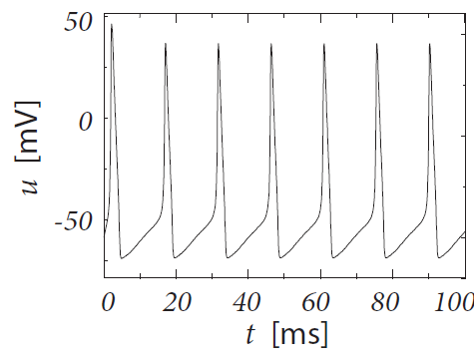
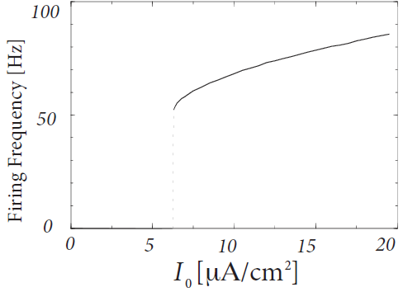
Neuronal Dynamics – 2.4. Threshold in HH model
Constant current input
I0
I
C
g_{K}
g_{Na}
g_{l}
Threshold?
for repetitive firing
(current threshold)
Notes:
If we are above this minimal current, the model generates regular firing. If you're below this threshold current, then the model shows constant firing.
对于constant current，可能存在一个阈值。

Slide 33
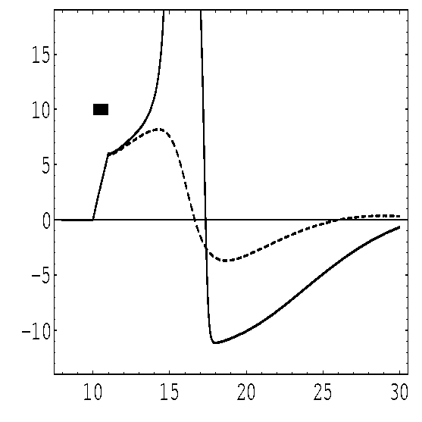
Neuronal Dynamics – 2.4. Threshold in HH model
pulse input
inside
I(t)
Ka
Na
outside
Ion channels
Ion pump
Threshold?
- AP if amplitude 7.0 units
- No AP if amplitude 6.9 units
(pulse with 1ms duration)
(and pulse with 0.5 ms duration?)
Notes:
The value 7.0 is completely uninformative because it depends on the shape of the pulse and the duration of a pulse, and many other things.

Slide 34
Neuronal Dynamics – 2.4. Threshold in HH model
pulse input
I(t)
m₀(u)
h₀(u)
u
u
Mathematical explanation
Stim.
Notes:
在这个公式里面，看不到一个类似于在EIF模型中我们有的threshold，但是的确存在类似的现象。那是什么呢？藏在了哪里？
藏在m和h里面。钾离子，h和（u-E_na）同时控制了na导致的电流继续流入。

Slide 35
Neuronal Dynamics – 2.4. Threshold in HH model
pulse input
I(t)
m₀(u)
h₀(u)
u
u
Stim.
Where is the threshold?
Blackboard!
Notes:
M > h = n
In fact, there is no threshold. There cannot be a threshold in this system of coupled non-linear differential equations. Everything is smooth.

Slide 36
Neuronal Dynamics – 2.4. Threshold in HH model
pulse input
I(t)
m₀(u)
h₀(u)
u
u
Stim.
Why start the explanation
with m and not h?
What about n?
Where is the threshold?

Slide 37
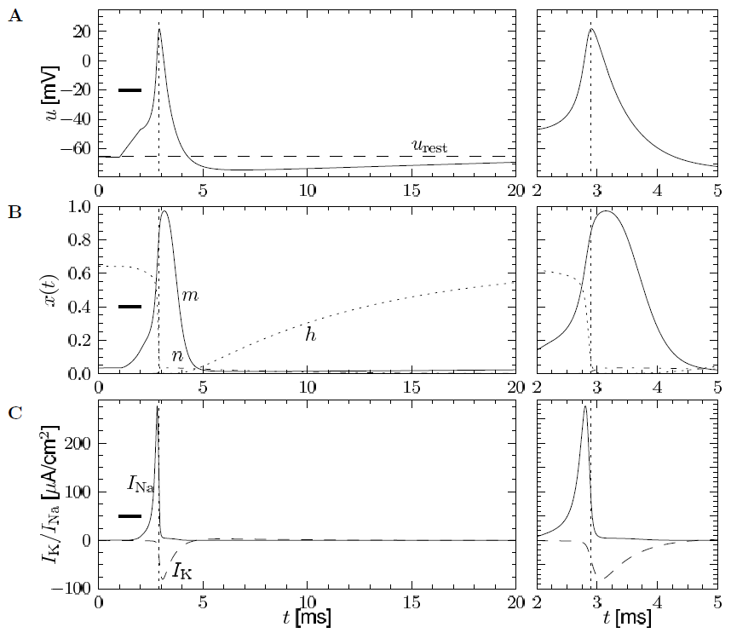
Neuronal Dynamics – 2.4. Threshold in HH model

Slide 38
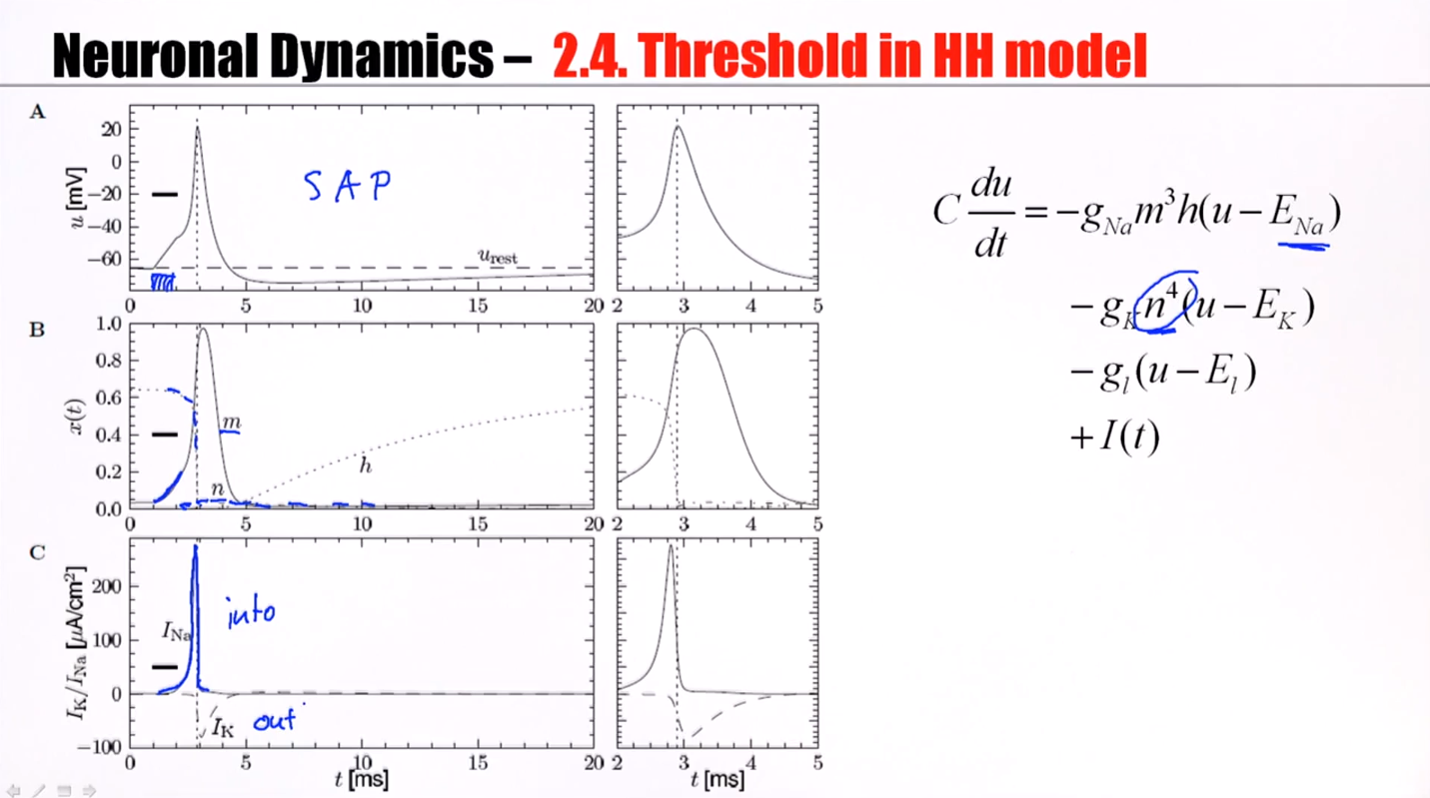

Slide 39
Neuronal Dynamics – 2.4. Threshold in HH model
First conclusion:
There is no strict threshold:
Coupled differential equations
‘Effective’ threshold
in simulations?
Notes:
There's something like an effective threshold, because there's a regime where the differential equations are very, very, very sensitive to small changes in the input. And this is what gives, effectively, rise to a threshold.

Slide 40
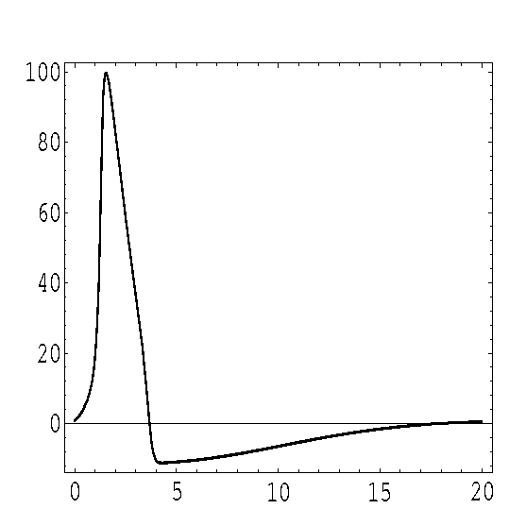
Neuronal Dynamics – 2.4. Refractoriness in HH model
Where is the firing threshold?
Action potential
refractoriness
100
100
mV
mV
0
0
0
ms
20
strong
stimuli
Strong
stimulus
Strong
stimulus
Refractoriness! Harder to elicit a second spike
Notes:
It's more difficult to elicit a second spike during a few milliseconds after the first spike.

Slide 41
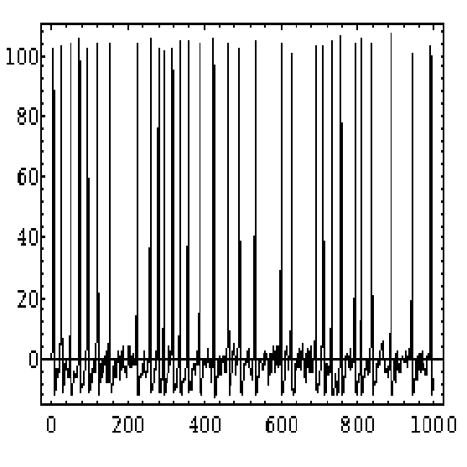
Neuronal Dynamics – 2.4. Simulations of the HH model
100
mV
Stimulation with
time-dependent
input current
0
I(t)

Slide 42
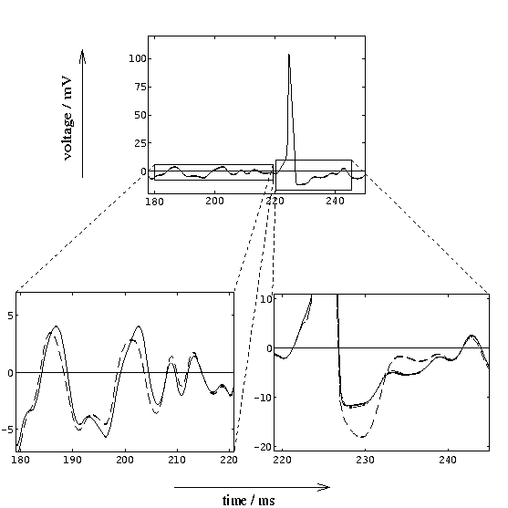
Neuronal Dynamics – 2.4. Simulations of the HH model
100
100
mV
mV
0
0
mV
5
I(t)
Subthreshold
response
0
Spike
-5

Slide 43
Neuronal Dynamics – 2.4. Threshold in HH model
I2
Step current input
I
Notes:
横坐标最终电流，纵坐标电流差

Slide 44
Neuronal Dynamics – 2.4. Threshold in HH model
Where is the firing threshold?
I(t)
There is no threshold
- no current threshold
- no voltage threshold
pulse input
I2
step input
I
‘effective’ threshold
- depends on typical input
ramp input

Slide 45
Neuronal Dynamics – 2.4. Type I and Type II
Hodgkin-Huxley model
with other parameters
(e.g. for cortical pyramidal
Neuron )
Hodgkin-Huxley model
with standard parameters
(giant axon of squid)
Response at firing threshold?
Type I type II
ramp input/
constant input
f-I curve
f-I curve
f
f
I0
I0
I0

Slide 46
Neuronal Dynamics – 2.4. Hodgkin-Huxley model
4 differential equations
no explicit threshold
effective threshold depends
on stimulus
BUT: voltage threshold good
approximation
Giant axon of the squid
→ cortical neurons
Change of parameters
More ion channels
Same framework

Slide 47
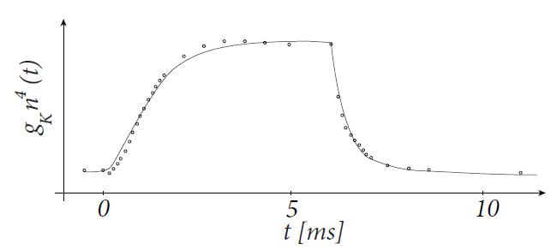
Exercise 3.1-3.3 – Hodgkin-Huxley – ion channel dynamics
voltage step
u2
Determine ion channel dynamics
u
inside
Ka
Na
Ion channels
Ion pump
outside
I
C
g_{K}
stimulus
apply voltage step
n₀(u)
Next Lecture at:
11.38
u
u
adapted from
Hodgkin&Huxley 1952

Slide 48
Biological Modeling of Neural Networks
Week 2 – part 5: Detailed Biophysical Models
2.1 Biophysics of neurons
- Overview
2.2 Reversal potential
- Nernst equation
2.3 Hodgkin-Huxley Model
2.4 Threshold in the
Hodgkin-Huxley Model
- where is the firing threshold?
2.5. Detailed biophysical models
- the zoo of ion channels
Week 2 – Biophysical modeling:
The Hodgkin-Huxley model
Wulfram Gerstner
EPFL, Lausanne, Switzerland

Slide 49
Neuronal Dynamics – 2.5 Biophysical models
inside
Ka
Na
outside
Ion channels
Ion pump
α
β

Slide 50
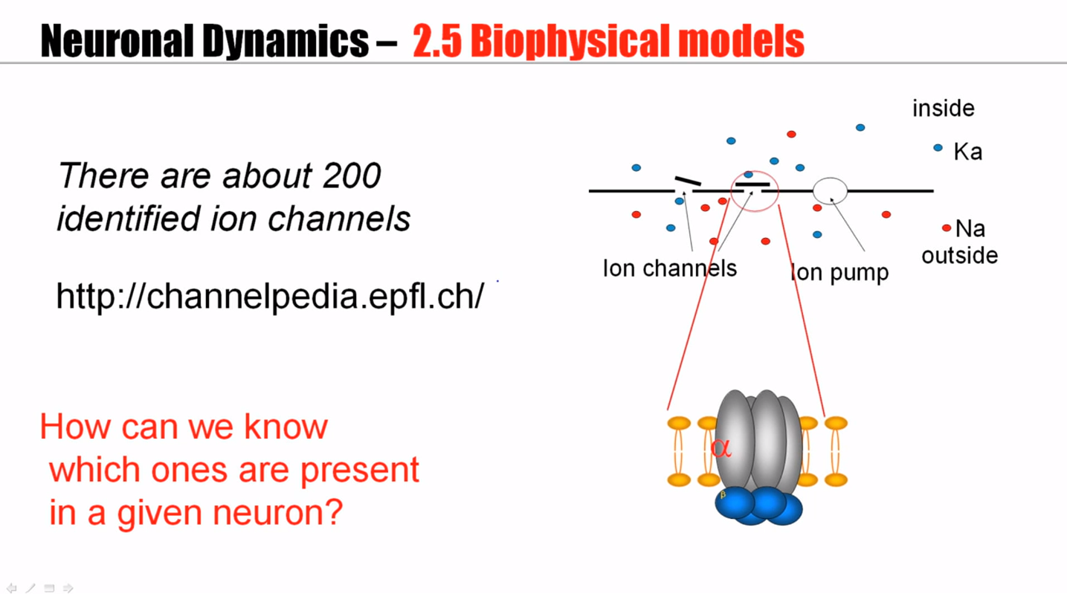

Slide 51
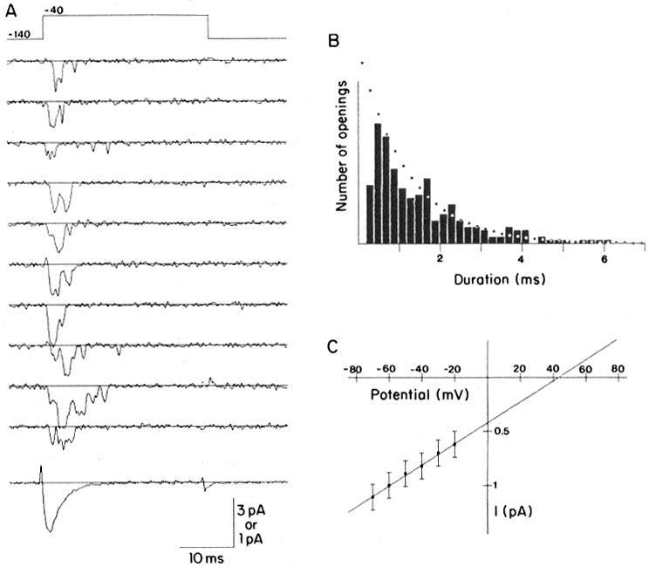
Neuronal Dynamics – 2.5 Ion channels
Na⁺
K⁺
Steps:
Different number
of channels
Ca²⁺
Ions/proteins
Na+ channel from rat heart (Patlak and Ortiz 1985)
A traces from a patch containing several channels.
Bottom: average gives current time course.
B. Opening times of single channel events
Notes:
If you add up the results of many, many of these experiments, you get a smooth current curve. And this is the one described by the formalism of Hodgkin and Huxley.

Slide 52
Neuronal Dynamics – 2.5 Biophysical models
inside
Ka
There are about 200
identified ion channels
Na
outside
Ion channels
Ion pump
http://channelpedia.epfl.ch/
How can we know
which ones are present
in a given neuron?
α
β

Slide 53
Ion Channels investigated in the study of
α
Toledo-Rodriguez, …, Markram (2004)
Voltage Activated K⁺ Channels
Kv
α
β
Kv1
Kv2
Kv3
Kv4
Kv5
Kv6
Kv8
Kv9
β
Kvβ
KChIP
+
+
Kvβ1
Kvβ2
Kvβ3
Kv1.1
Kv1.2
Kv1.3
Kv1.4
Kv1.5
Kv1.6
Kv2.1
Kv2.2
Kv3.1
Kv3.2
Kv3.3
Kv3.4
Kv4.1
Kv4.2
Kv4.3
KChIP1
KChIP2
KChIP3
CB
PV
CR
NPY
VIP
SOM
CCK
pENK
Dyn
SP
CRH
CGRP
I
C
g_{Na}
g_{l}
g_{Kv1}
g_{Kv3}
schematic mRNA
Expression profile
Notes:
You can extract a little liquid, a little droplet of liquid from the neuron, and analyze the profile of messenger RNA. And ion channels are proteins. Proteins can be genetically characterized. For example, for the potassium channels, there are different families. There are voltage dependent potassium channels, voltage activated potassium channels.

Slide 54
Model of a hypothetical neuron
I
inside
Ka
C
g_{Na}
g_{l}
g_{Kv1}
g_{Kv3}
Na
outside
Ion channels
Ion pump
stimulus
How many parameters per channel?
Erisir et al, 1999
Hodgkin and Huxley, 1952

Slide 55
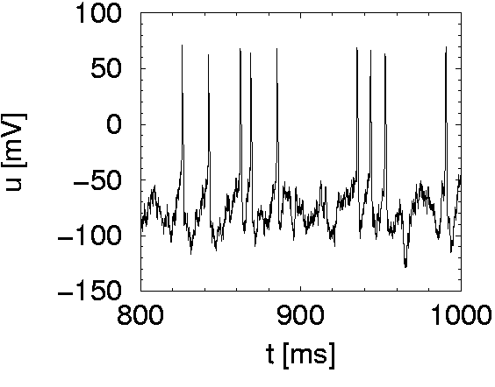
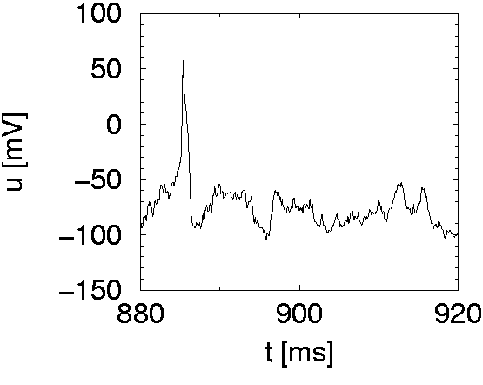
Model of a hypothetical neuron
Spike
I(t)
I
Subthreshold
C
g_{Na}
g_{l}
g_{Kv1}
g_{Kv3}
Detailed model, based
on ion channels

Slide 56
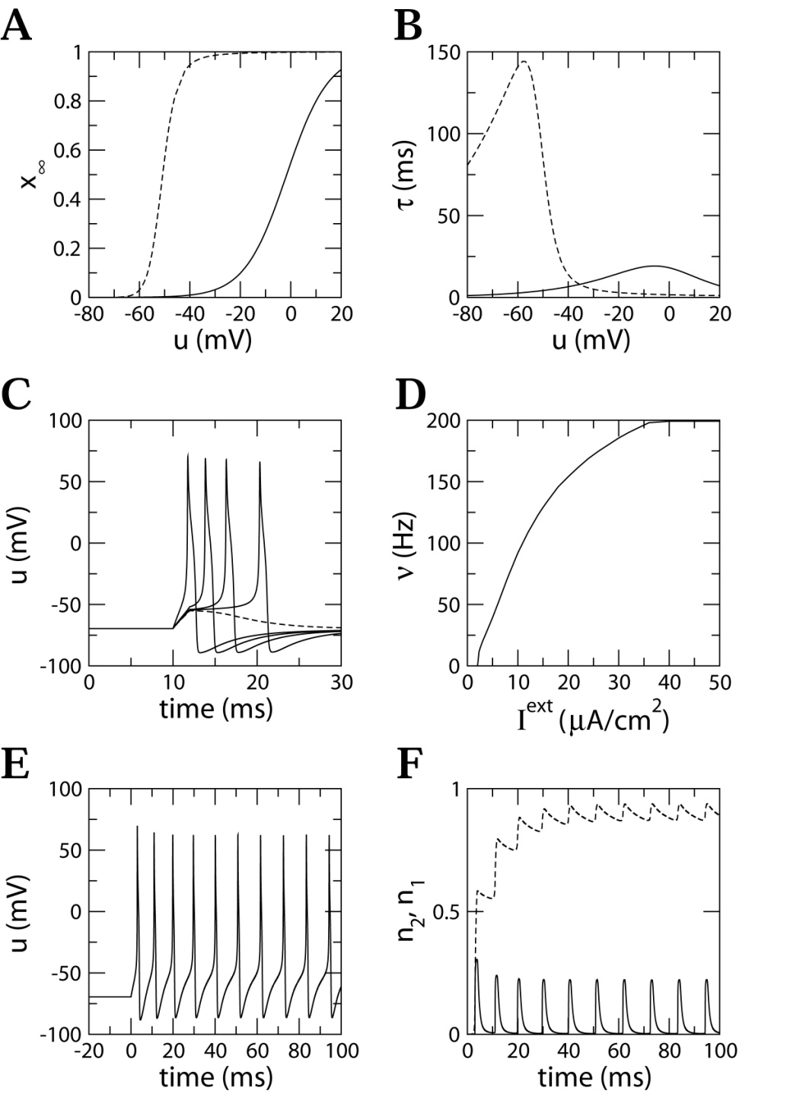
Model of a hypothetical neuron (type I)
Current pulse
Biophysical model, based
on ion channels
constant
current
I
- Delayed AP initiation
- Smooth f-I curve
type I neuron
C
g_{Na}
g_{l}
g_{Kv1}
g_{Kv3}

Slide 57
Neuronal Dynamics – 2.5 Adaptation
Functional roles of channels?
- Example: adaptation
u
I
Notes:
There are many different channels – what are potential function roles?
Adaptation means that the spike intervals get longer and longer.

Slide 58
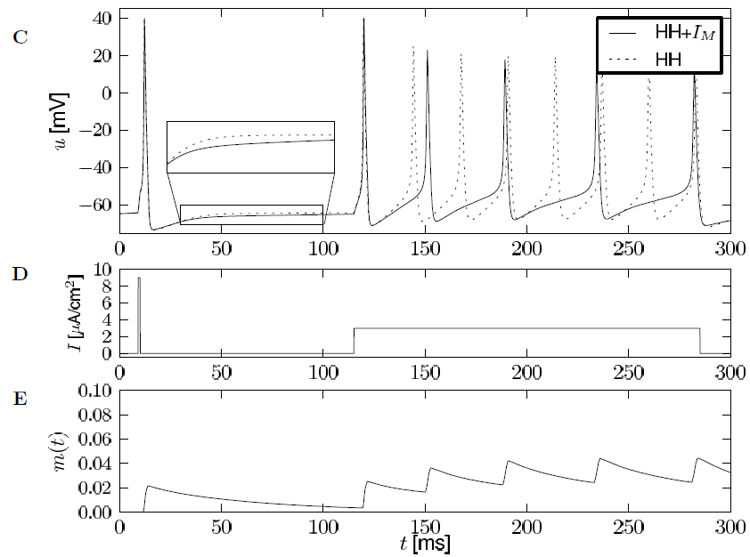
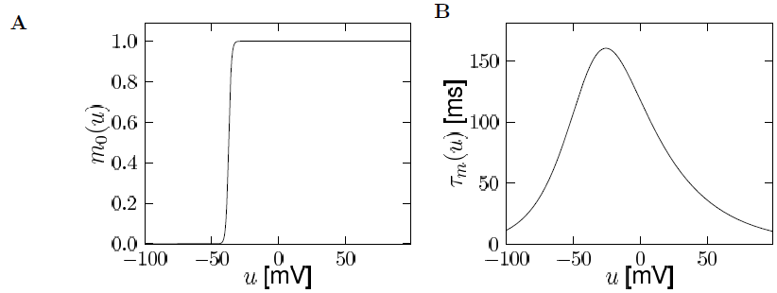
Neuronal Dynamics – 2.5 Adaptation: IM -current
M current:
- Potassium current
- Kv7 subunits
- slow time constant
Yamada et al., 1989
IM current is one of many potential sources of adaptation
Notes:
A图中可以看到，这个电流一般在spike的时候，才会激活。由于tau很大，m降落的时间很慢，所以m值会不断地累积到越来越大。
这是一个钾离子电流，因此导致膜电位降低（比静息电位），所以膜电位就越来越低，SAP也越来越小。

Slide 59
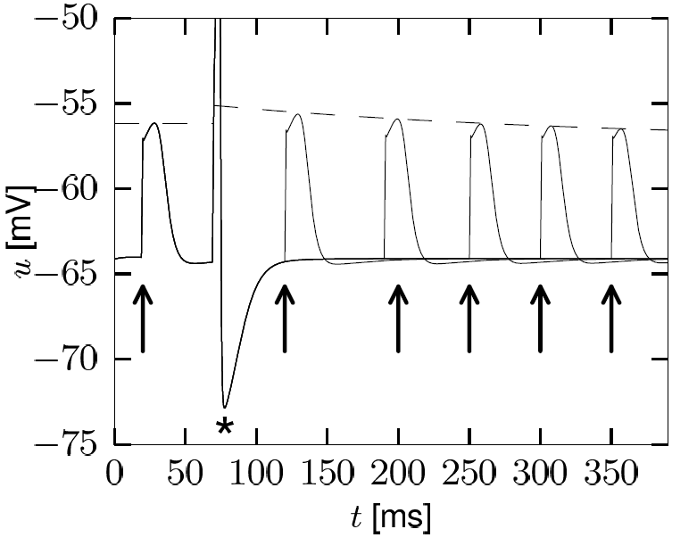
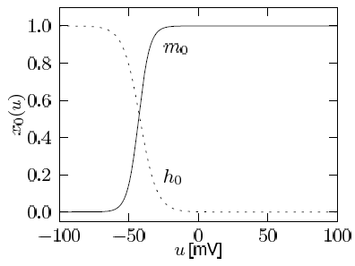
Neuronal Dynamics – 2.5 Adaptation – INaP current
current:
- persistent sodium current
- fast activation time constant
- slow inactivation ( ~ 1s)
INaP current
increases firing threshold
source of adaptation
Aracri et al., 2006
Notes:
It is persistly activated, it has a very, very slow inactivation time constant. Therefore, for the second spike, many sodium channels are still in an inactivated state and they cannot participate in the generation of the next action potential.

Slide 60
Neuronal Dynamics – 2.5 Biophysical models
inside
Ka
Na
outside
Ion channels
Ion pump
β
Hodgkin-Huxley model
provides flexible framework
Hodgkin&Huxley (1952)
Nobel Prize 1963
Notes:
They deserved their nobel prize!
Still in use today, over 50 years later, the basis of many big simulation projects,

Slide 61
Exercise 4 – Hodgkin-Huxley model – gating dynamics
A) Often the gating dynamics is formulated as
Calculate
B) Assume a form
How are a and b related to and in the equations
C ) What is the time constant ?
Notes:
How many parameters do we need if a channel just has the activation variable m?
我不会！
Exercise 4 in question set 2

Slide 62
Now Computer Exercises:
Play with Hodgkin-Huxley model

Slide 63
Neuronal Dynamics – References and Suggested Reading
- Hodgkin, A. L. and Huxley, A. F. (1952). A quantitative description of membrane current and its application to conduction and excitation in nerve. J Physiol, 117(4):500-544.
Ranjan, R.,et al. (2011). Channelpedia: an integrative and interactive database for ion channels. Front Neuroinform, 5:36.
Toledo-Rodriguez, M., Blumenfeld, B., Wu, C., Luo, J., Attali, B., Goodman, P., and Markram, H. (2004). Correlation maps allow neuronal electrical properties to be predicted from single-cell gene expression profiles in rat neocortex. Cerebral Cortex, 14:1310-1327.
Yamada, W. M., Koch, C., and Adams, P. R. (1989). Multiple channels and calcium dynamics. In Koch, C. and Segev, I., editors, Methods in neuronal modeling, MIT Press.
- Aracri, P., et al. (2006). Layer-specic properties of the persistent sodium current in sensorimotor cortex. Journal of Neurophysiol., 95(6):3460-3468.
Reading: W. Gerstner, W.M. Kistler, R. Naud and L. Paninski,
Neuronal Dynamics: from single neurons to networks and
models of cognition. Chapter 2: The Hodgkin-Huxley Model, Cambridge Univ. Press, 2014
OR W. Gerstner and W. M. Kistler, Spiking Neuron Models, Chapter 2, Cambridge, 2002

